Slide 1
Redux Fundamentals
Because State Management Can Be Hard

Slide 2
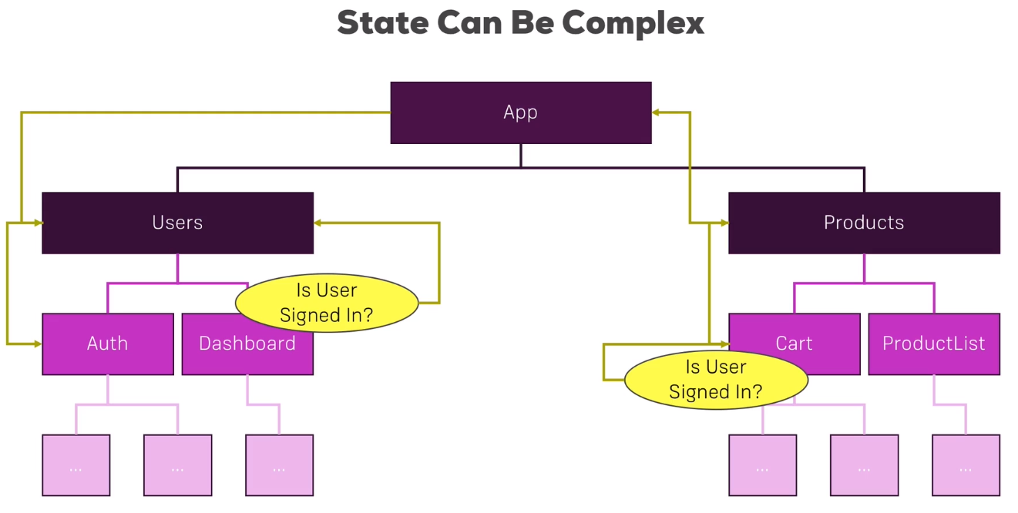

Slide 3
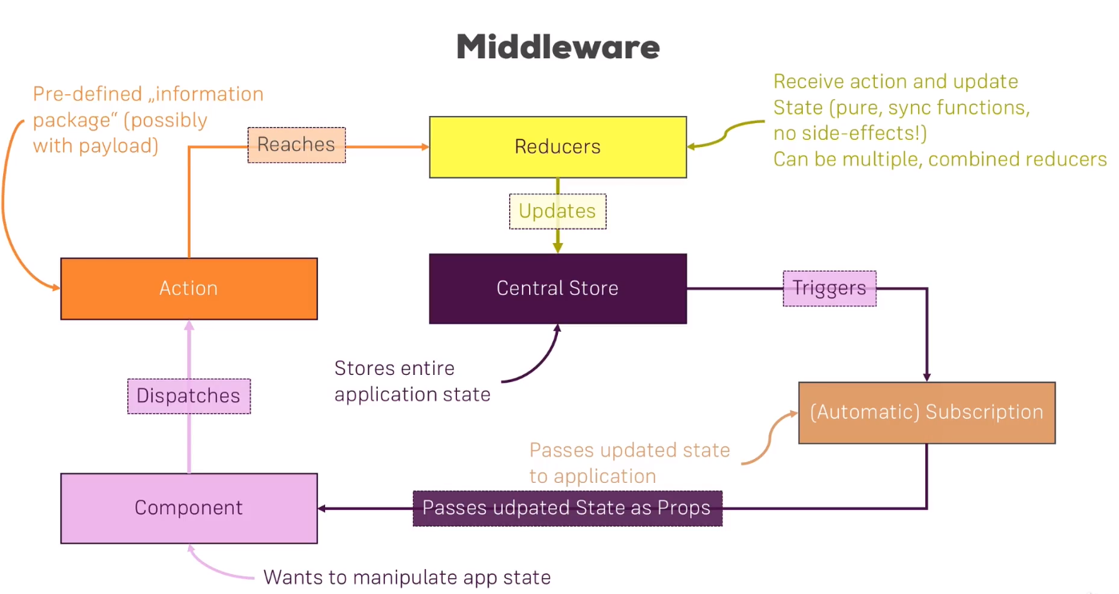

Slide 4
Should every state be handled by Redux?
Nooooooooooooooooooooooooooooooooo

Slide 5
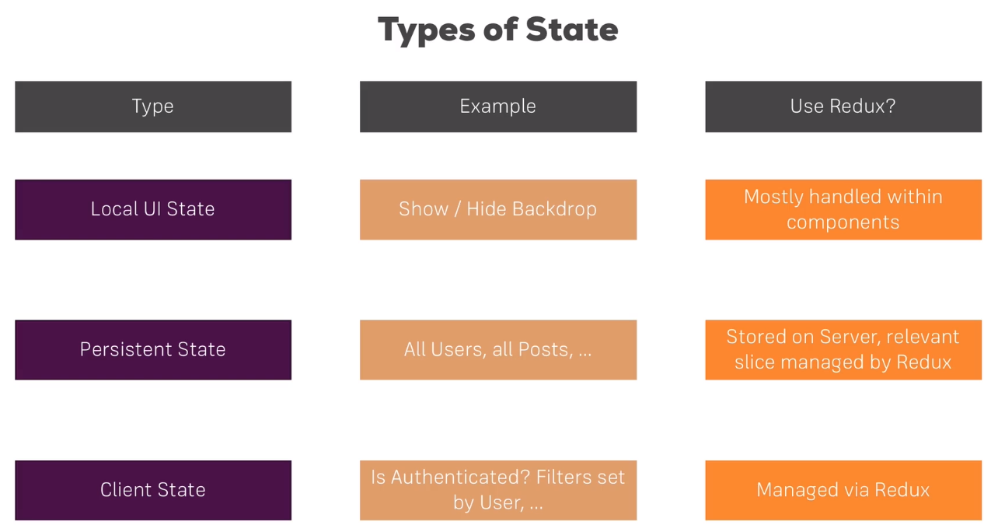

Slide 6
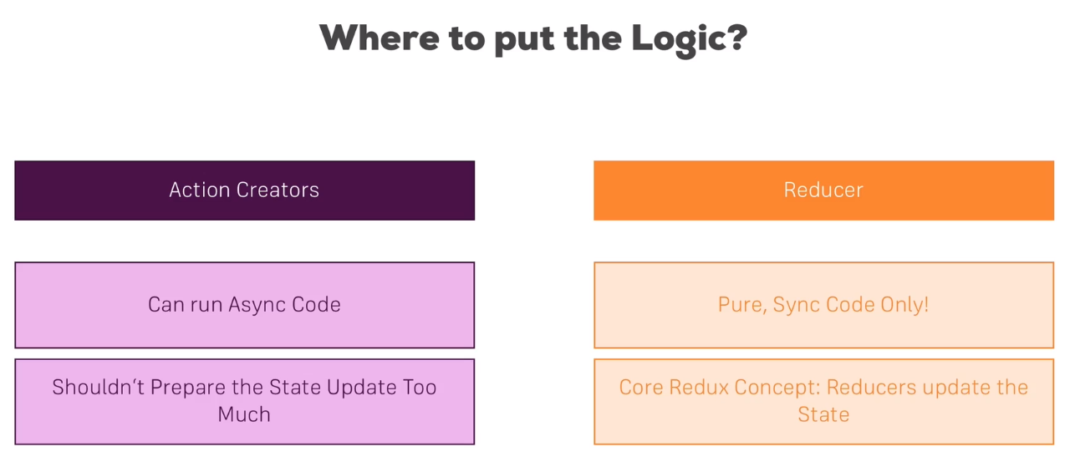

Slide 7
The Most Important Thing About Where to Place Data Transforming Logic
Stay Consistent

